Slide 1
كتاب جافا سكريبت في تطبيقات النت
باب: الجداول وما احتوت عليه من المسائل.
حدثنا شيخنا عبد المالك إبن زمام عن شيخه فاتح آروش قال:

Slide 2
Arrays with javascript
Array ?
JavaScript can hold an array of variables in an Array object.
To define an array, either use the brackets notation or the Array object notation:
var myArray = [1, 2, 3];

Slide 3
Adressing:
We can use the brackets [] operator to address a specific cell in array.
Addressing uses zero-based indices that mean the first adresse is Zero (0).
Var myArray = [1, 2, 3];
console.log(myArray[0]); // prints out 1
console.log(myArray[1]); // prints out 2

Slide 4
Arrays in JavaScript are sparse, meaning that we can also assign variables to random locations even though previous cells were undefined.
var myArray = [];
myArray[3] = "hello " ;
console.log(myArray);
Question:
What’s the result of previous Program ?
Answer:
[undefined, undefined, undefined, "hello"]

Slide 5
Array Elements:
Because JavaScript Arrays are just special kinds of objects, you can have elements of different types stored together in the same array.
var myArray = ["string", 10, {}];
for (var i = 0; i < myArray.length; i++) {
console.log(" Element " +i+" is " ,myArray[i])
};

Slide 6
Var myArray = [1, 2, 3];
Replace an element:
myArray[2] = 3;
Console.log(myArray);
Add a new one :
myArray[3] = 10;
Console.log(myArray);
Get Array length:
Var myArray = [1, 2, 3];
Console.log(" Length = ", myArray.length);

Slide 7

Append / Remove Methods:
Push/ pop, unshift / shift:
Push(+)
Shift(-)
unshift(+)
pop(-)
push(): Appends an element to the end.
shift(): Get an element from the beginning (advancing the queue).
The 2nd element becomes the 1st.

Slide 8
unshift(): Add the element to the beginning of the array
pop(): Extracts the last element of the array.

Slide 9
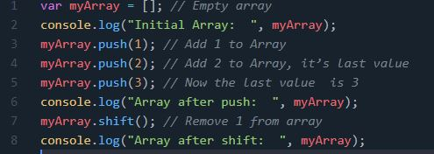
FIFo Example:
https://codepen.io/laysamy/pen/bGpxQLN
Exercice: Write LIFO program for 3 elements from an empty array

Slide 10
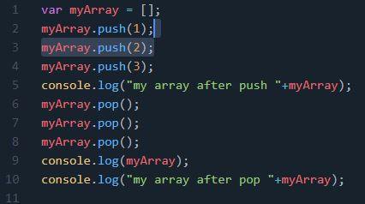
Solution: LIFO program
https://codepen.io/laysamy/pen/NWNLEeN

Slide 11
- Methods push and unshift can add multiple elements at once.
Var myArray = [];
myArray.push(1,2,3);
myArray.unshift (4,5,6);
- Arrays in JavaScript can work both as a queue and as a stack. They allow you to add/remove elements both to/from the beginning or the end. This kind of data structure that allows this, is called deque (double-ended queue ).

Slide 12
Multidimensional arrays:
var matrix = [
[1, 2, 3],
[4, 5, 6],
[7, 8, 9]
];
console.log( matrix[1][1] ); // 5, the central element

Slide 13
Loop over the elements of array :
for (var i=0; i<arr.length; i++){
console.log(arr[i])};
// works fastest, old-browser-compatible.
for (var item of arr);{
console.log(item)};}
//Modern syntax for items only: doesn’t give access to the number of the current element, just its value,
for (var i in arr) // never use : iterates over all properties, not only the numeric ones

Slide 14
Some array methods:
some methods require advanced knowledge of the functions and CallBacks

Slide 15
Some array methods:
array.forEach(): The forEach() method calls a function once for each element in an array, in order. Return value is undefined.
Note: the function is not executed for array elements without values.

Slide 16
forEach() Syntax:
array.forEach(function(curVal, index, arr), thisValue)
curVal : The value of the current element
index : The array index of the current element
arr : The array object the current element belongs to
thisArg: A value to be passed to the function to be used as its "this" value.( when thisArg is empty "undefined" will be passed as its "this").

Slide 17
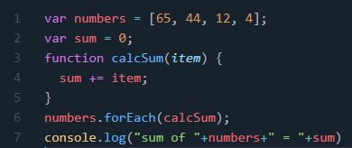
https://codepen.io/laysamy/pen/GRZXwVR

Slide 18
array.map(): The map () method return (creates) a new array with the results of calling a function provided on each element of the calling array.
Return Value is Array.

Slide 19
map() Syntax:
var newArr = arr.map(callback [, thisArg])
1-Callback: The function that is used to create an element of the new array. It uses three arguments:
A-curenValue: The value of the array element to
process.
B-index (Optional): The index of the element that is
processed by the function.
C-Array(Optional): The array on which the map
method was called.
2- thisArg: The value to use for this when executing callback (default value is Window browser).

Slide 20
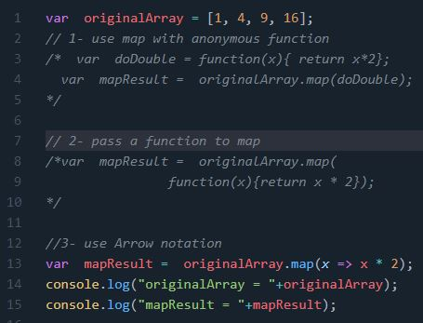
https://codepen.io/laysamy/pen/RwaYEGN

Slide 21
foreach vs map discussion

Slide 22
array.find(): The find() method returns the value of the first element in an array that pass a test (provided as a function). If it finds an array element find() returns the value of that array element (and does not check the remaining values) Otherwise it returns undefined

Slide 23
find() Syntax:
Array.find(function(currentValue, index, arr),thisValue)
curVal : The value of the current element
index : The array index of the current element
arr : The array object the current element belongs to
thisArg: A value to be passed to the function to be used as its "this" value.( when thisArg is empty "undefined" will be passed as its "this").

Slide 24
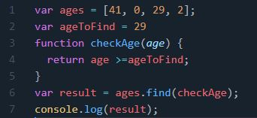
https://codepen.io/laysamy/pen/vYGzveO

Slide 25
array.findIndex(): returns the index of the first element in an array that pass a test (provided as a function). If it finds an array element findIndex() returns the index of that array element (and does not check the remaining values) Otherwise it returns -1

Slide 26
findIdex() Syntax:
Array.findIndex(function(curVal, index, arr), thisValue)
curVal : The value of the current element
index : The array index of the current element
arr : The array object the current element belongs to.
thisValue: A value to be passed to the function to be used as its "this" value.( when thisArg is empty "undefined" will be passed as its "this").

Slide 27
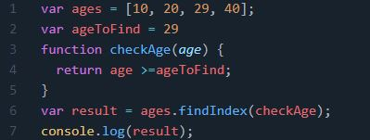
https://codepen.io/laysamy/pen/GRZXPyq

Slide 28
array. includes (): The includes() method determines whether an array contains a specified element.
This method returns true if the array contains the element, and false if not.
Note: The includes() method is case sensitive.

Slide 29
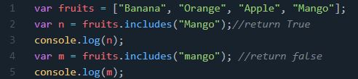
includes () Syntax:
array.includes(element, start)
element : The element to search for.
start : Default 0. At which position in the array to start the search
https://codepen.io/laysamy/pen/MWyqZQB

Slide 30
array.filter(): creates an array filled with all array elements that pass a test (provided as a function). Returns An Array containing all the array elements that pass the test. If no elements pass the test it returns an empty array.

Slide 31
filter() Syntax:
array.filter(function(curVal , index, arr), thisValue)
curVal : The value of the current element
index : The array index of the current element
arr : The array object the current element belongs to.
thisValue: A value to be passed to the function to be used as its "this" value.( when thisArg is empty "undefined" will be passed as its "this").

Slide 32
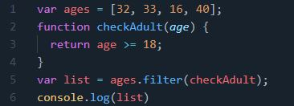
https://codepen.io/laysamy/pen/wvGERXe

Slide 33
Array. reduce (): Reduces the array to a single value. It executes a provided function for each value of the array (from left-to-right). The return value of the function is stored in an accumulator (result/total).

Slide 34
Reduce() Syntax:
array.reduce(function(total, curVal, curInd, arr), initVal)
Total: The initialValue, or the previously returned value of the function
curVal : The value of the current element
curInd : The array index of the current element
arr : The array object the current element belongs to
initVal : A value to be passed to the function as the initial value

Slide 35
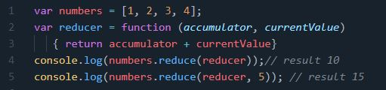
https://codepen.io/laysamy/pen/OJNorom

